Slide 1
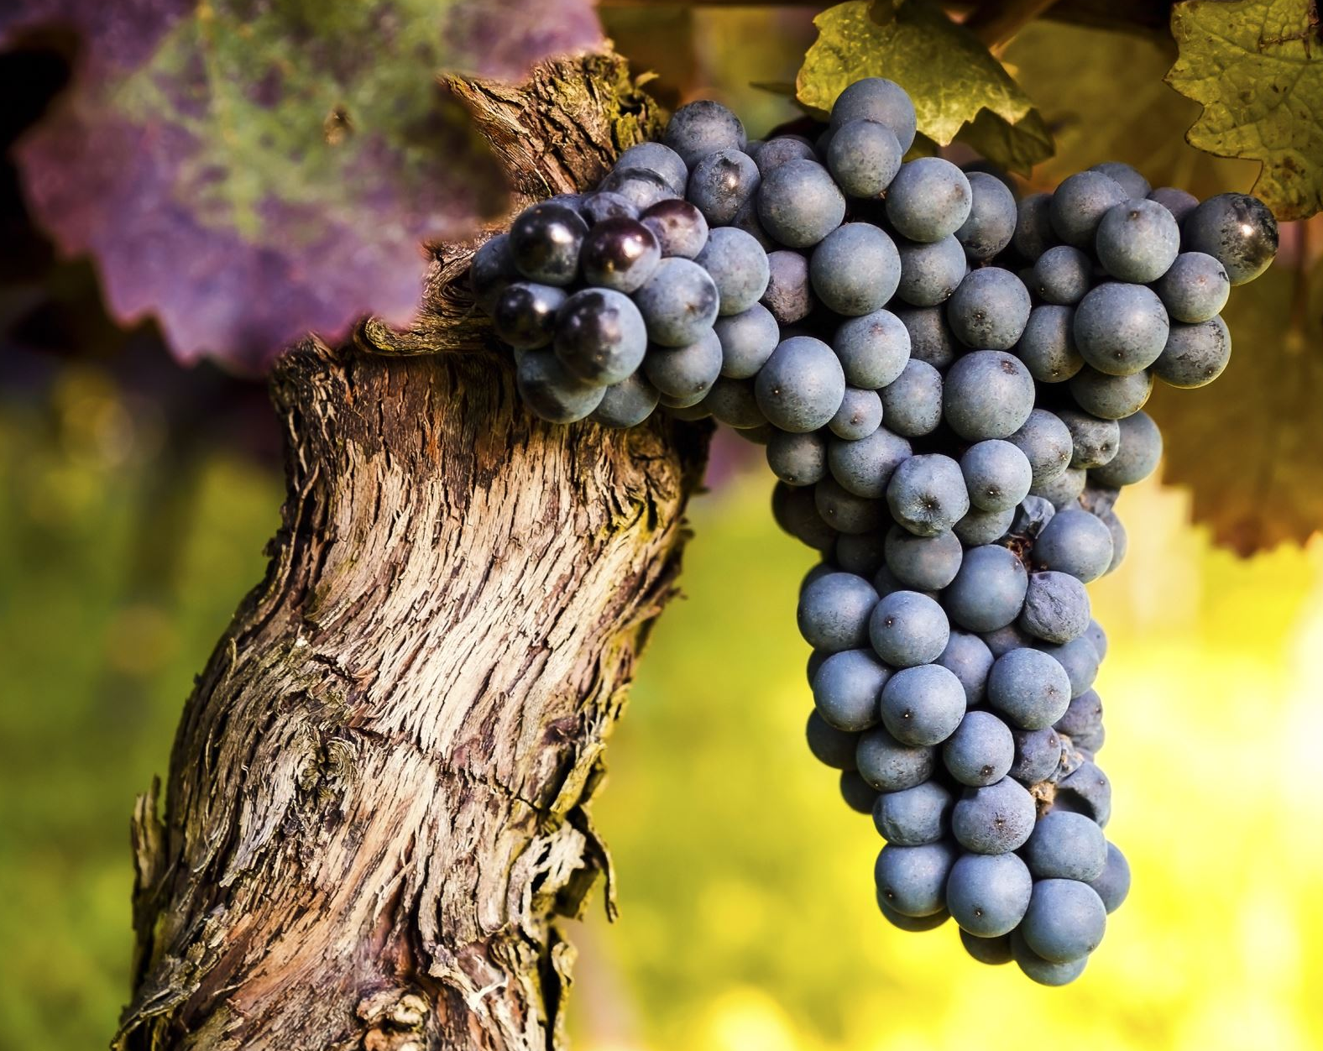
Assessing Key Determinants of Wine Quality
Data Forge
Zainab Anwar & Blake Armstrong
December 15, 2024
Notes:
Zainab

Slide 2
Overview
General Information: Our Client/Objectives
Exploring the Data
Conclusion
Modelling Techniques
Takeaways & Use Cases
Insights from the Model
Notes:
Zainab
Exploring -> Modeling -> Insights

Slide 3
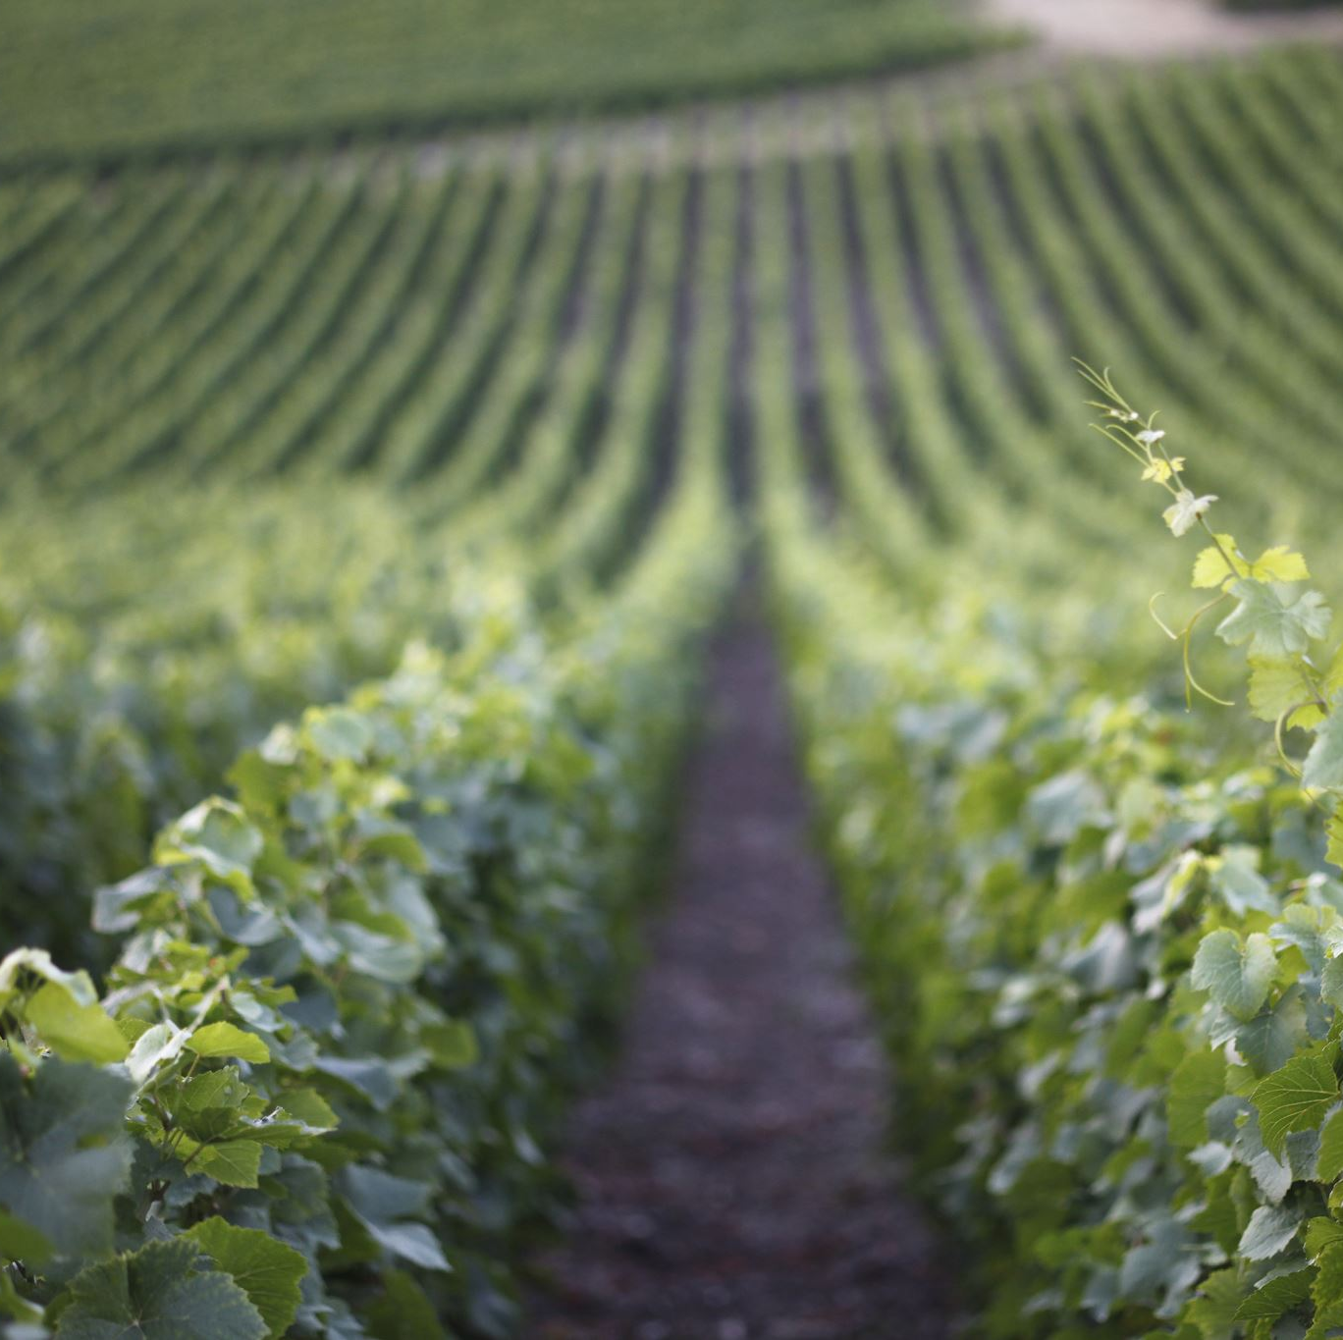
General Information
About Us: Data Forge
Client: Robert Renzoni Vineyards | Olivia Blue (Head Vintner)
Question of Interest: What factors make a wine high-quality, and how can this information help optimize production processes?
Objectives:
Build a predictive model minimizing the MAE
Determine key factors that influence wine-quality and contribute to high-quality wine
Provide actionable insights for our client
Notes:
Zainab

Slide 4
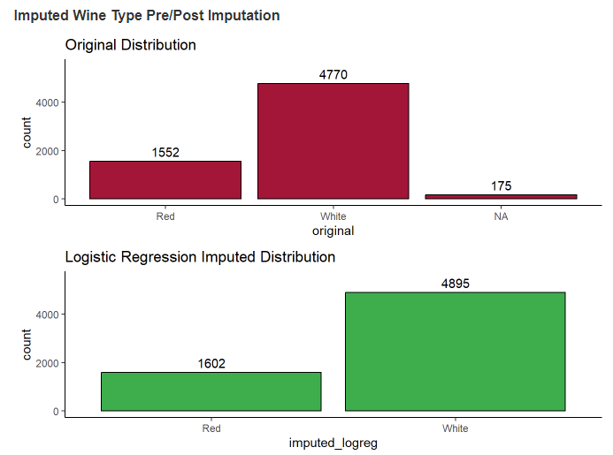
Exploring the Data
Datasets:
'WineTrain.csv'
File with columns for ID and factors that may affect wine quality
13 Factors and 5463 Observations
Contained no missing data
'WineTest.csv'
File with same columns as the train set, excluding the quality.
'WineTypesandLocations.csv'
File with columns for ID, Wine Types, and production Location
3 Variables and 6497 Observations
Contained 175 missing Wine Type
Utilized logistic regression based on all variables to impute.
Maintained overall split percentages
Notes:
Zainab

Slide 5
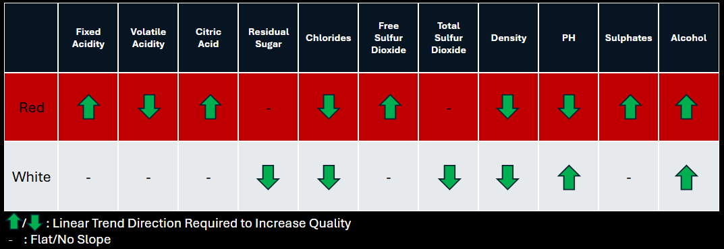
Exploring the Data (cont.)
Quickly identified differing quality drivers by wine type
This will be taken into consideration during modelling
While some variables exhibit no rate of change, it is observable that as quality increases, the IQR range decreases (lower variability)
Notes:
Zainab

Slide 6

Modelling Techniques
Naïve Bayes Model:
Able to handle categorical and numerical data without encoding categorical variables
Looped over every single combination of variables to determine the most accurate combination
Trained red and white wine together/separately to account for type-specific factors
Using the loop, this is over 8000/4000 possible combinations, respectively
Data Splitting:
80/20 train-validation split
Set seed at 123

Slide 7

Insights from Naïve Bayes Model
Initial Model:​
Red & White Wine Combined:
Mean Absolute Error (MAE): 0.4437
Top Quality Indicators: Citric Acid, Density, pH, Location
Refined Model: Given different drivers, will recombine
Red Wine:
Mean Absolute Error (MAE): 0.3369
Top Quality Indicators: Volatile Acidity, Residual Sugar, Chlorides, Total Sulfur Dioxide, Sulphates, Location
White Wine:
Mean Absolute Error (MAE): 0.4585
Top Quality Indicators: Density, pH, Sulphates, Location
Combined MAE: 0.4287

Slide 8

Takeaways & Use Cases
Red Wine
More variables can be quickly adjusted to obtain higher quality wine
Out of the identified trends by variable, adjust those that are easiest to control first (lowest hanging fruit)
White Wine
Harder to control given more variables focused on reducing variability rather than direct increases/decreases
Use Case
Utilize the model with cost/revenue data to drive highest impact decisions to the company.

Slide 9
Conclusion
The MAE is still higher than we would like as this is a blend of all red and white wines, we suggest that varietal be included in the dataset (Cabernet Sauvignon, Pinot Noir, etc.) if possible to focus on leading factors by varietal that directly impact Robert Renzoni vineyards.
Focus on Robert Renzoni's most popular products first to drive highest ROI changes
Obtain feedback from RRV to determine the easiest variables to fix for lowest cost (lowest hanging fruit)
Contacts:
Zainab Anwar: zanwar@mail.smu.edu
Blake Armstrong: armstrongb@mail.smu.edu

